Slide 1
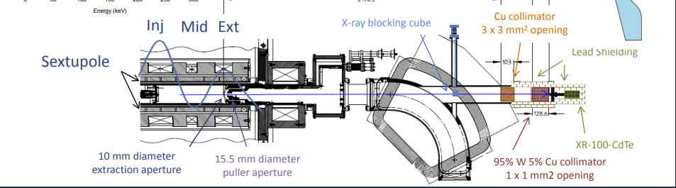
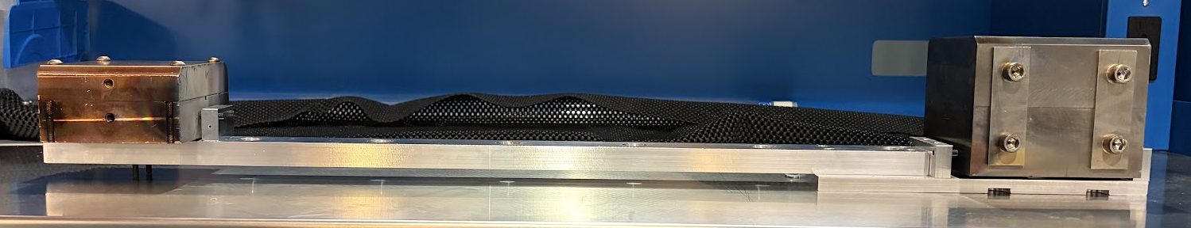
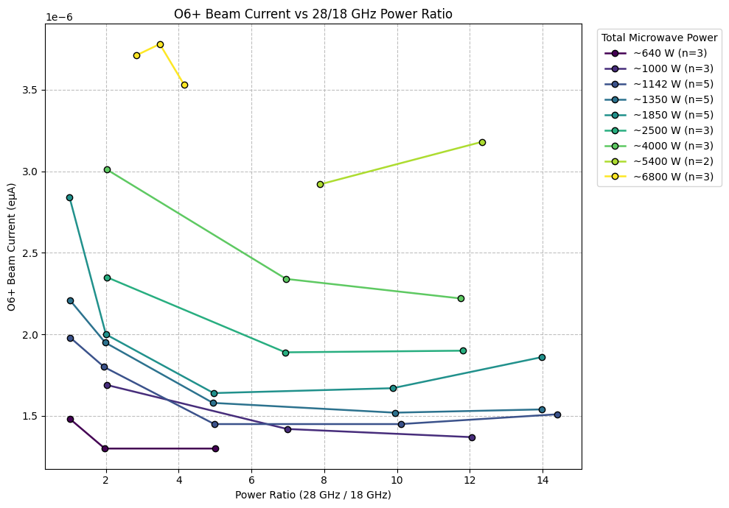
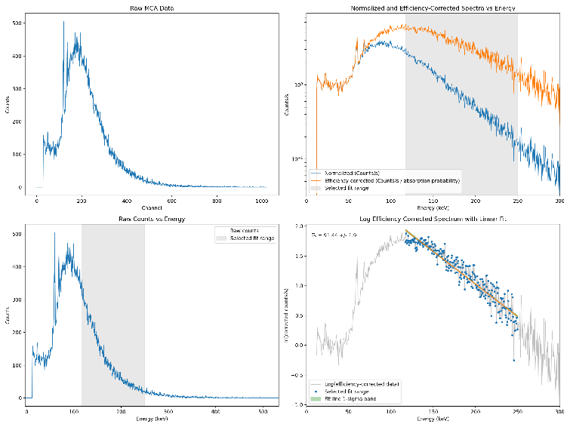
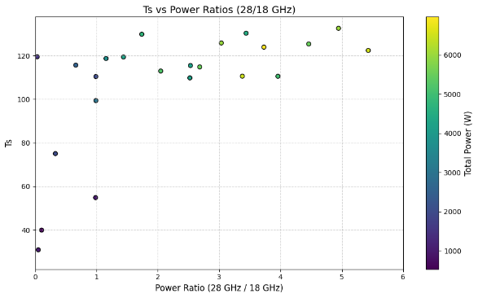
Bremsstrahlung Measurements of VENUS 3rd-Generation ECR Ion Source
88-Inch Cyclotron, Nuclear Science Division
N. Intwala
Experimental Setup
Diagram of setup
Introduction
Power Ratio Results
Conclusion
Methodology
Add diagram of set up of extraction beamline with distances
Future Work
Magnetic Field Results
Acknowledgments
References

Slide 3
Experimental Setup

